Slide 1
Passing Data Between Forms
Presented BY:Er.Sudan Prajapati

Slide 2
Introduction
Some of you would have faced a scenario where you wanted to pass data from one form to another in WinForms.
There are so many methods to pass data between forms in Windows application.
There are three important (easiest) ways of accomplishing this:
Using constructor
Using objects
Using properties

Slide 3
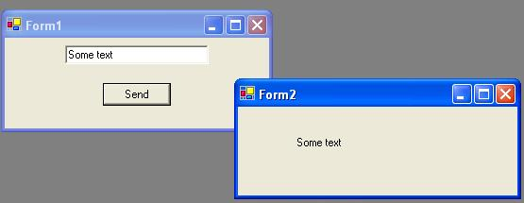

Slide 4
Step 1
Create a new project and select Windows application. This will create a default form as “Form1”. Step 2
Add a textbox and a button to the form.
Step 3
Add another Windows Form for receiving the data and to display it. Right click the project and select Add->Add Windows Form. Enter a name or use the default name “Form2.cs” and click ok button.
Step 4
Add a label to the second form to display the text from form1.

Slide 5
The Constructor Approach
This is the the easiest method of all.
A method is invoked whenever you instantiate an object.
This method is called a constructor
Code a constructor for form2 class with one string parameter.
In the constructor, assign the text to the label’s text property.
Instantiate form2 class in form1’s button click event handler using the constructor with one string parameter and pass the textbox’s text to the constructor.

Slide 6
Step 1
Code a constructor for form2 class as below:
public Form2(string strTextBox)
{
InitializeComponent();
label1.Text=strTextBox;
}

Slide 7
Step 2
Instantiate form2 class in form1’s button click event handler as below:
private void button1_Click(object sender, System.EventArgs e)
{
Form2 frm=new Form2(textBox1.Text);
frm.Show();
}

Slide 8
The Properties Approach
Properties allow clients to access class state as if they were accessing member fields directly, while actually implementing that access through a class method.
In this method, we are going to add one property to each form. In form1 we are going to use one property for retrieving value from the textbox and in form2, one property to set the label’s text property.
Then, in form1’s button click event handler, we are going to instantiate form2 and use the form2’s property to set the label’s text.

Slide 9
Follow the below steps:
Step 1
Add a property in form1 to retrieve value from textbox:
public string _textBox1{
get{return textBox1.Text;}
}

Slide 10
Follow the below steps:
Step 2
Add a property in form2 to set the labels’ text:
public string _textBox{
set{label1.Text=value;}
}

Slide 11
Follow the below steps:
Step 3
In form1’s button click event handler, add the following code:
private void button1_Click(object sender, System.EventArgs e){
Form2 frm=new Form2();
frm._textBox=_textBox1;
frm.Show();}

